Slide 1

CREDIT CARD FRAUD DETECTION
Aishwarya Wagdarkar – 002964461
Ruchita Yarlagadda – 002920198
Pranaya Chilamkuri – 002924536
Sai Srujan Penta - 002928427

Slide 2
PROBLEM STATEMENT & OBJECTIVE
For several banking institutions, banking fraud represents a danger to achieving this objective. This is a problematic situation for both banks and customers in terms of significant financial losses, trust, and reputation.
Machine learning-based credit card fraud detection in the banking sector is not just a trend, but also a requirement for them to set up proactive monitoring and fraud protection procedures. These institutions are using machine learning to cut down on time-consuming manual reviews, pricey chargebacks and penalties, and rejections of valid transactions.
In this project we detect fraudulent credit card transactions with the help of Machine learning models.

Slide 3
DATA SET
The data set includes credit card transactions made by European cardholders over a period of two days in September 2013. Out of a total of 2,84,807 transactions, 492 were fraudulent. This data set is highly unbalanced, with the positive class (frauds) accounting for 0.172% of the total transactions. The data set has also been modified with principal component analysis (PCA) to maintain confidentiality.
Apart from ‘time’ and ‘amount’, all the other features (V1, V2, V3, up to V28) are the principal components obtained using PCA. The feature 'time' contains the seconds elapsed between the first transaction in the data set and the subsequent transactions. The feature 'amount' is the transaction amount. The feature 'class' represents class labeling, and it takes the value of 1 in cases of fraud and 0 in others.

Slide 4
PACKAGES
Xgboost
Sklearn
Scipy
Seaborn
Numpy
Pandas
Matplot

Slide 5
ALGORITHMS
Logistic Regression
KNN model
Decision Tree model with gini and entropy
Random Forest
XGBoost Model
SVM model with sigmoid kernel model

Slide 6
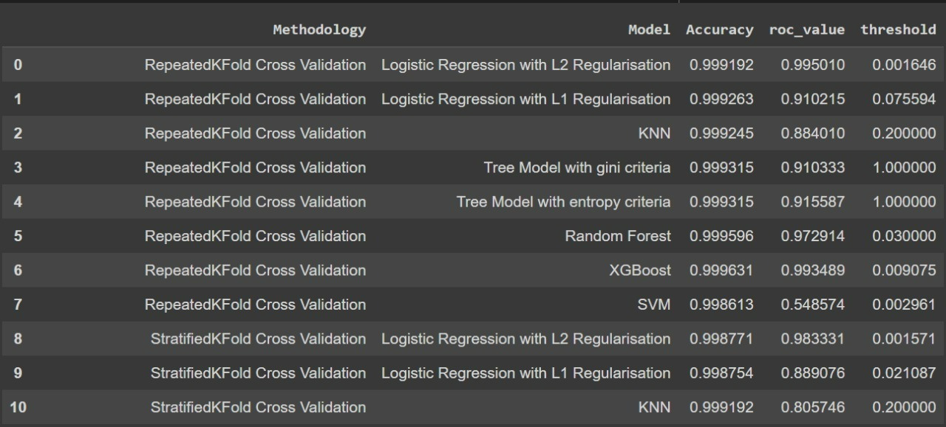
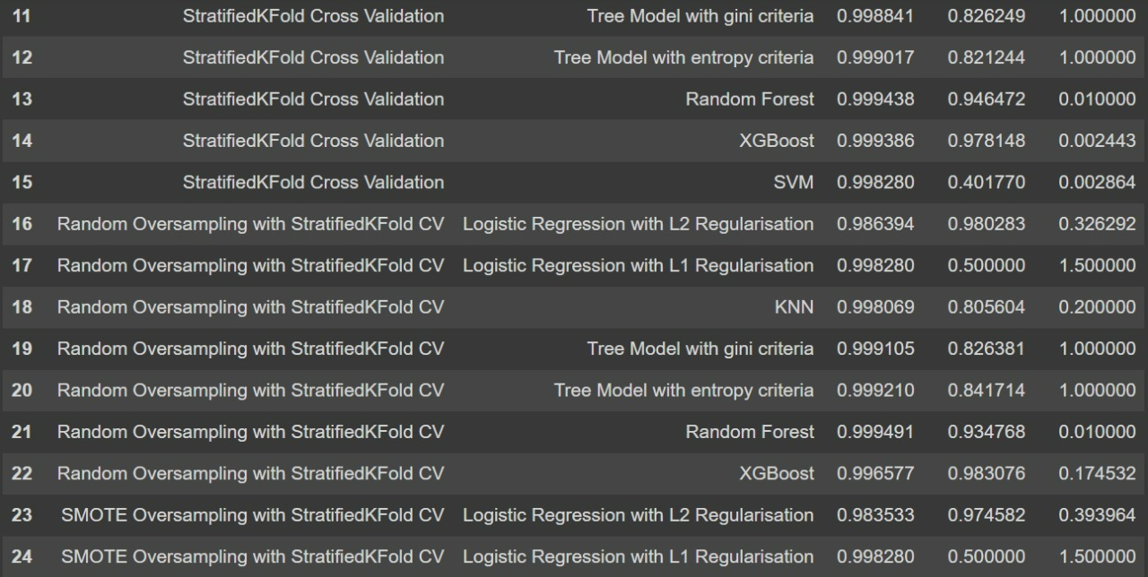
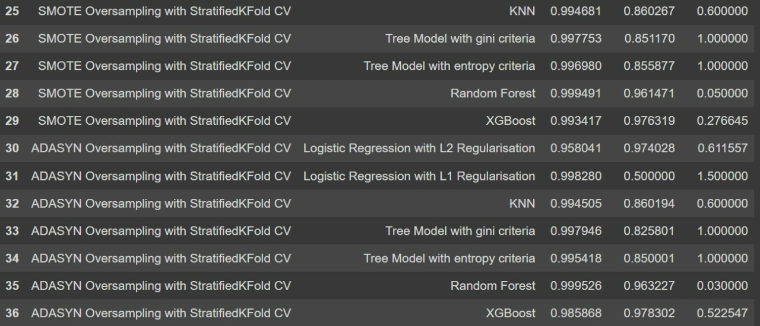
RESULTS

Slide 7


RESULTS
In the oversample cases, of all the models we build found that the XGBOOST model with Random Oversampling with StratifiedKFold CV gave us the best accuracy and ROC on oversampled data.

Slide 8
THANK YOU!!

